Slide 1
Capstone Project Phase 1
breast cancer cells classification using CNN
Supervisor: Ronen Zilber Students: Shenhav Hezi, Tomer Boyanjo

Slide 2
Table of Contents
Introduction
Breast cancer as of today
Motivation
Approach to solution
CNN
DenseNet
Inception V4
Datasets: Breakhis RSNA
Researched hyperparameters
Diagrams
GUI
Evaluation

Slide 3
breast cancer cells classification using CNN on histopathology and mammography imaging - Introduction
Breast cancer is the second most diagnosed cancer worldwide. Breast cancer occurs in four main types: normal, benign, in-situ carcinoma and invasive carcinoma.
Breast cancer can be diagnosed using several approaches, two of them:
Histopathology images, which are microscopic images of breast tissue that are extremely useful in early treatment of the cancer.
Mammography which is specialized medical imaging that uses a low-dose x-ray system to see inside the breasts. A mammography exam, called a mammogram, aids in the early detection and diagnosis of breast diseases in women.

Slide 4
Breast cancer as of today
In 2022, an estimated 287,500 new cases of invasive breast cancer will be diagnosed in women in the U.S. as well as 51,400 new cases of non-invasive (in situ) breast cancer.
65% of breast cancer cases are diagnosed at a localized stage, for which the 5-year relative survival rate is 99%.
Breast cancer is the most common cancer in American women, except for skin cancers. It is estimated that in 2022, approximately 30% of all new women cancer diagnoses will be breast cancer.

Slide 5
Motivation
There are places and countries where there is shortage of specialist doctors, and patients cannot get results of test to find whether they have breast cancer quickly enough which can worsen survivability rates for them. Early detection using automated classification tool can bring about these aspects:
earlier detection can drastically improv the patient's survival chances.
waiting time for a diagnosis will be reduced and patient can get treatment earlier.
When there is lack of specialist doctors, these tools can help serve as secondary opinions

Slide 6
Approach to solution
we expect to build a system that classify if a patient has breast cancer based on mammography and histopathological imaging with higher accuracy than the automatic classifications of today.
in places where there is shortage of specialist doctors, our system classify both on mammography and histopathology as at risk for cancer, and the patient will be considered more urgent for diagnose of a specialist doctor.
We will use the BreakHis (Histopathology) and RSNA Screening mammography dataset to research 2 CNN architectures (DenseNet, Inception V4) while testing different hyperparameters to maximize our accuracy of breast cancer detection.

Slide 7
CNN
Convolutional neural networks are a specialized type of artificial neural networks that use a mathematical operation called convolution.
There are usually 3 types of layers in CNNs:
convolution layer - Its purpose is to extract features from the image. applying a filter on an input, passing the result to the next layer (feature maps).
pooling layers – Pooling layers reduce the dimensions of data by combining the outputs of neuron clusters at one layer into a single neuron in the next layer.?
fully connected layer - maps the extracted features into final output, They come as the last layers after convolution and pooling and these layers take the output of previous layers to classify the output.?

Slide 8
DenseNet
The problems arise with CNNs when they go deeper. This is because the path for information from the input layer until the output layer (and for the gradient in the opposite direction) becomes so big, that they can get vanished before reaching the other side and here is where the DenseNet have the edge and overcome this problem. DenseNet is a type of convolutional neural network (CNN) that utilizes dense connections between layers, through Dense Blocks, where we connect all layers (with matching feature-map sizes) directly with each other in order to preserve the feed-forward nature, each layer obtains additional inputs from all preceding layers and passes on its own feature-maps to all subsequent layers. In order to gain maximum information and gradient flow, so each layer has direct access to the gradients from the loss. these connections patterns will decrease the vanishing of the gradient. In short: Densenet is a CNN that can get much deeper than other CNN's without decreasing its accuracy.

Slide 9
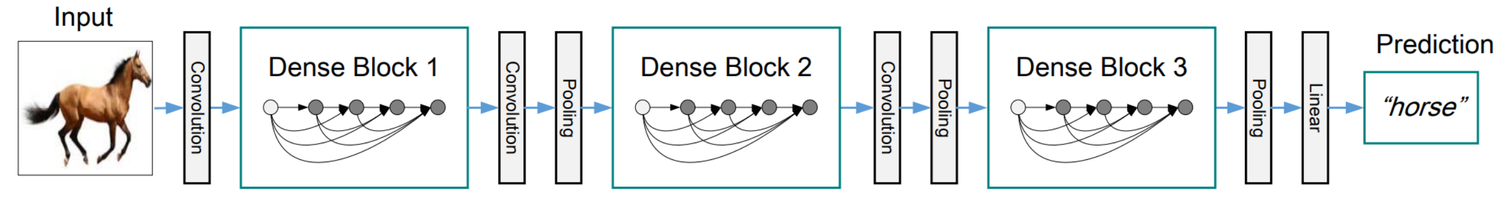
DenseNets are composed from Dense Blocks, the dimensions of the feature maps remains the same within a block, but the number of filters changes between them.
The L th layer has L inputs, consisting of the feature-maps of all preceding convolutional blocks. Its own feature-maps are passed on to all subsequent layers.
DenseNet layers are very narrow, adding only a small set of feature-maps to the “collective knowledge”.
Dense connectivity pattern requires fewer parameters, as there is no need to relearn unnecessary feature-maps.

Slide 10
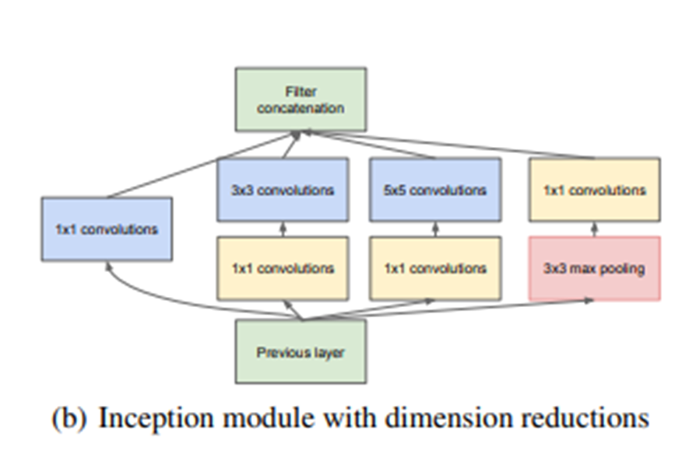
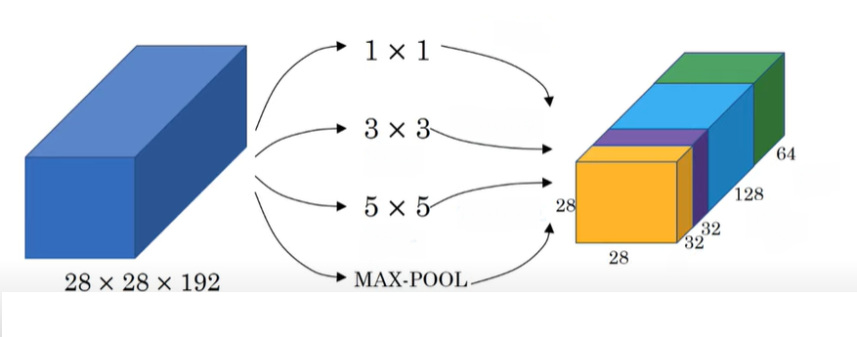
Inception V4
The inception network which was introduced as Googlenet in 2014 takes a new approach to deep layers models where before different types of convolutions and pooling layers were stacked upon each other but now in an inception module we combine within the same layer different convolutions and a pooling operation which all produces at the layer level an output with same dimensions only different depths which are than concatenated as an output of the layer and passed on unto the next.

Slide 11
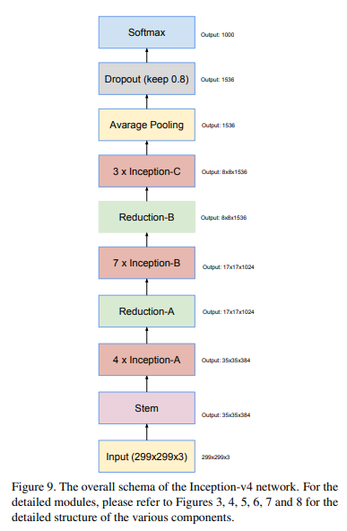
Inception v3 is also introduced in the same paper with v2 and is a variation of v2 with batch normalization on the auxiliary classifiers and not just on convolutions. the Inception architecture is highly tunable, meaning that there are a lot of possible changes to the number of filters in the various layers that do not affect the quality of the fully trained network. inception v4 is an updated version of inception which made use of advancements and newer tools from when v3 was published. researchers note not simplifying earlier choices in the architecture resulted in networks that looked more complicated than they needed to be and made changes

Slide 12
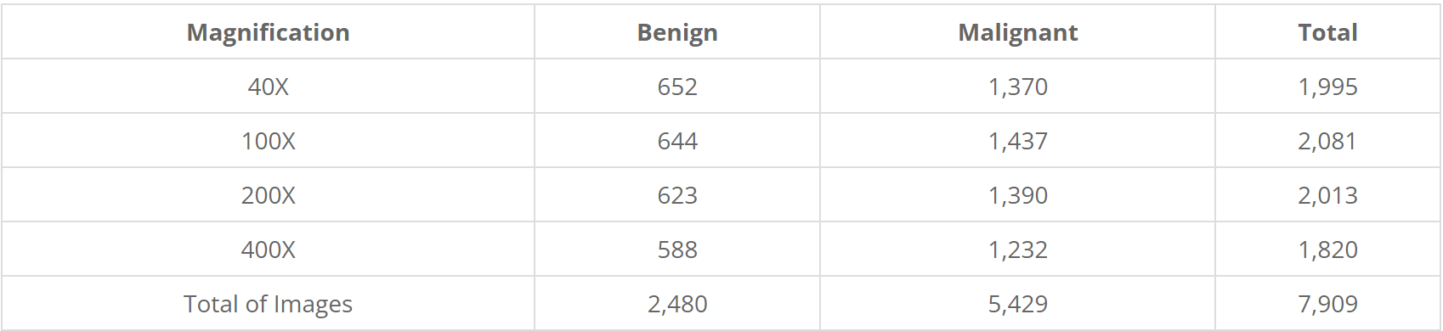
BreakHis
The Breast Cancer Histopathological Image Classification (BreakHis) composed of:
7,909 microscopic images of breast tumor tissue collected from 82 patients using different magnifying factors (40X, 100X, 200X, and 400X).
2,480 benign
5,429 malignant samples (700X460 pixels, 3-channel RGB, 8-bit depth in each channel, PNG format for both benign and malignant images).
The BreaKHis is structured as follows:

Slide 13
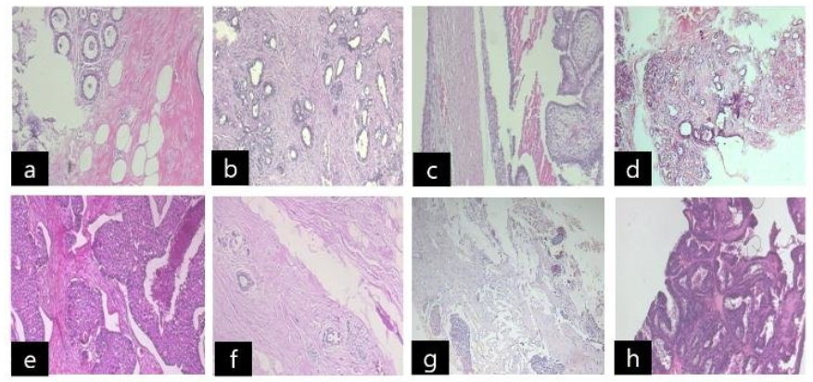
BreakHis
BreakHis dataset composed of benign and malignant images : benign [(a) : adenosis, (b) : fibroadenoma, (c) : phyllodes tumor, (d) : tubular adenoma], malignant [(e) : ductal carcinoma, (f) : lobular carcinoma, (g) : mucinous carcinoma, (h) : papillary carcinoma]
Source: https://www.researchgate.net/figure/BreakHis-dataset-composed-of-benign-and-malignant-images-benign-a-adenosis-b_fig2_327528970

Slide 14
RSNA
Radiological Society of North America (RSNA) Screening mammography breast cancer detection dataset composed of:
54713 files
size of 314.72gb
roughly 8,000 patients in the hidden test set (there are usually but not always 4 images per patient).
Contains the following labels:
cancer - Whether or not the breast was positive for malignant cancer.
BIRADS - 0 if the breast required follow-up, 1 if the breast was rated as negative for cancer, and 2 if the breast was rated as normal. Only provided for train.
invasive - If the breast is positive for cancer, whether or not the cancer proved to be invasive.

Slide 15
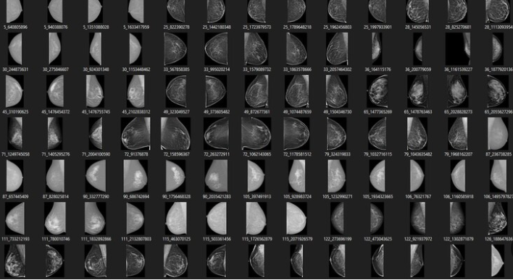
RSNA

Slide 16
Researched hyperparameters
Learning rate {0.1 – 0.000001}, learning rate determines the step size at each iteration while moving toward a minimum of a loss function.
Epochs {10, 50, 250}, specifies the number of epochs or full passes of the entire training dataset through the algorithm’s training or learning process.
Batch size {32, 64}, batch size is the number of samples that are passed through the model before the model is updated. The size of a batch must be less than the number of samples in the training dataset.
Dropout {0.2-0.5} Dropout is a technique where randomly selected neurons are ignored during training. They are “dropped out” randomly. Dropout helps combat overfitting of the model

Slide 17
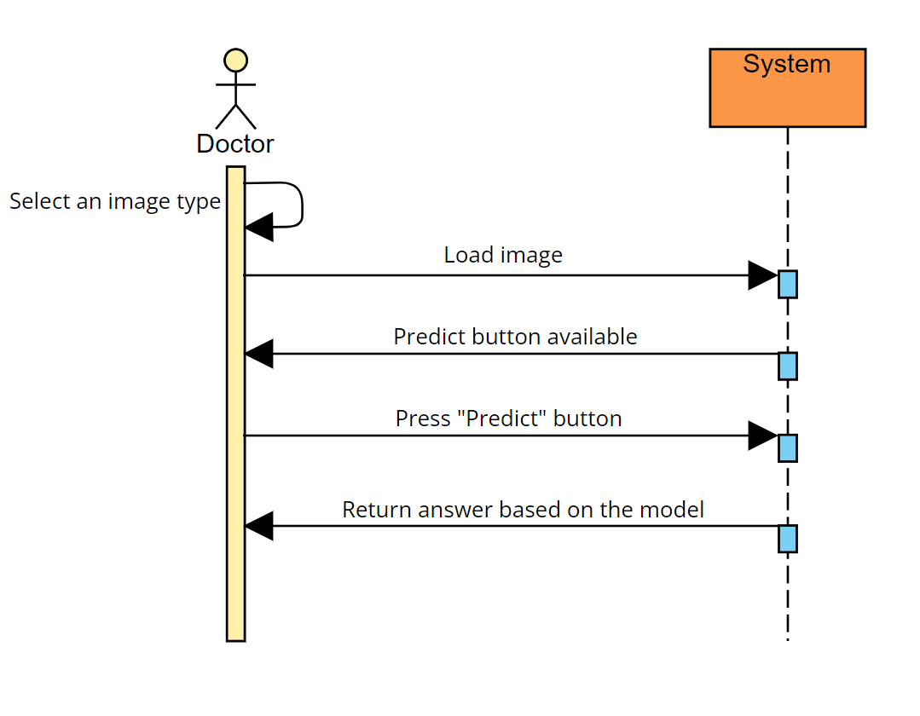
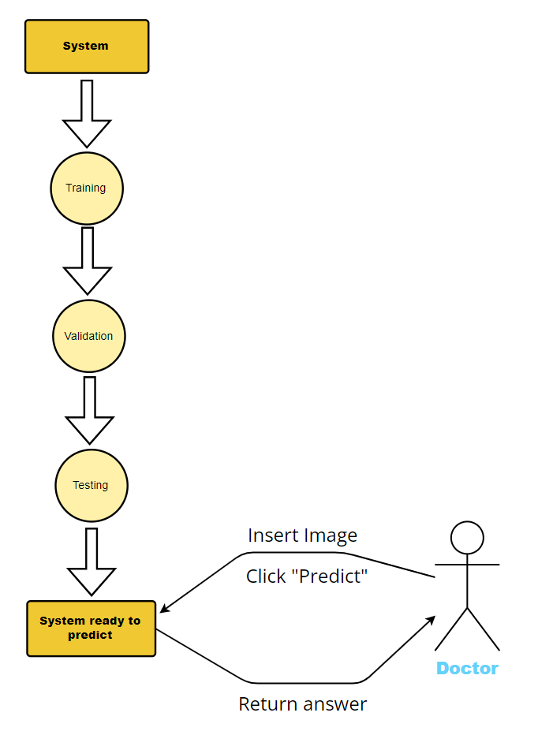
Diagrams
Flowchart diagram:
Sequence diagram:

Slide 18
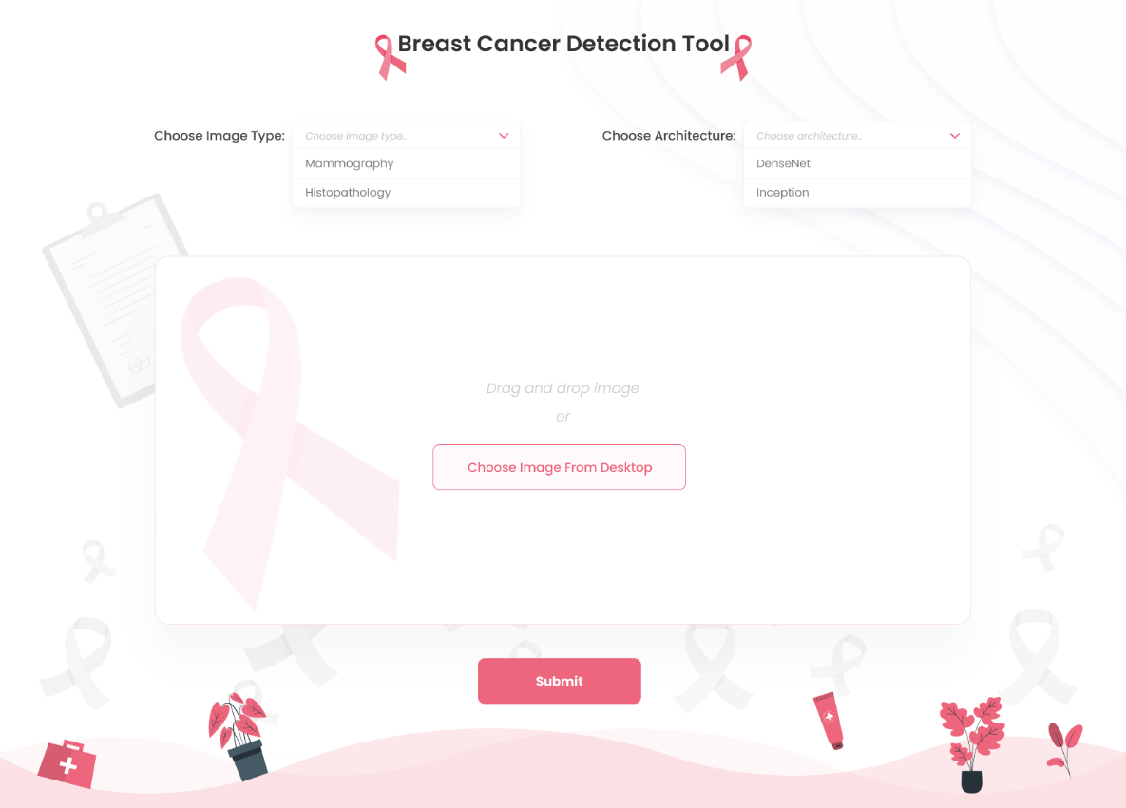
GUI

Slide 19
Evaluation
Case | Case test | Result
1 | Trying to predict without an image loaded | Error message: please lode image
2 | Load image without choosing image type | Error message: please choose image type
3 | Load wrong image (wrong format) | Error message: wrong format
4 | Load correct image and choose type and architecture | Image will appear on screen
5 | Try to submit image without choosing architecture | Error message: please choose architecture
6 | Try to submit with correct image and chosen type and architecture | Result message will appear on screen
7 | Load Image with low resolution | Result message with low predicted percentage
8 | Issue with loading the Image | Error message: Can't load image, please try again
9 | Low predict percentage (96%<) | Warning message: Predicted result is not accurate.

